Slide 1
Power BI Report

Slide 2
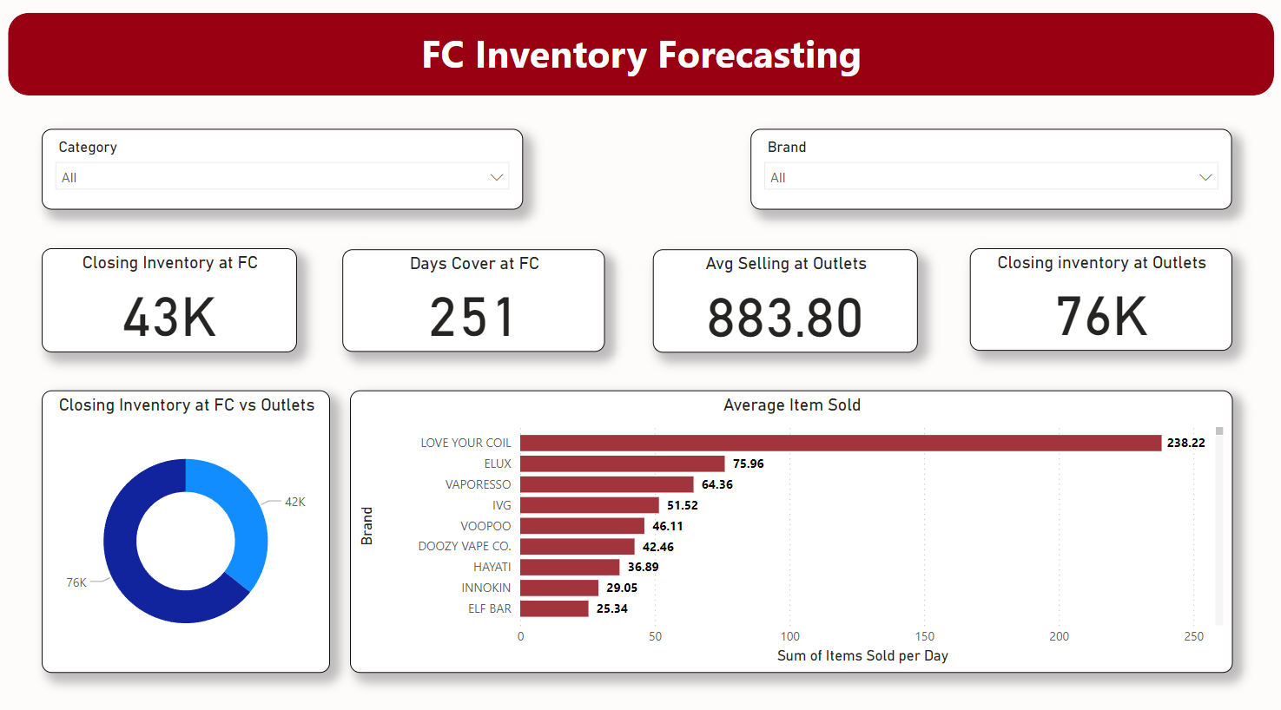
Warehouse Inventory Forecasting
It forecasts the availability of the product at warehouse depending on the inventory and sales at the outlets.

Slide 3
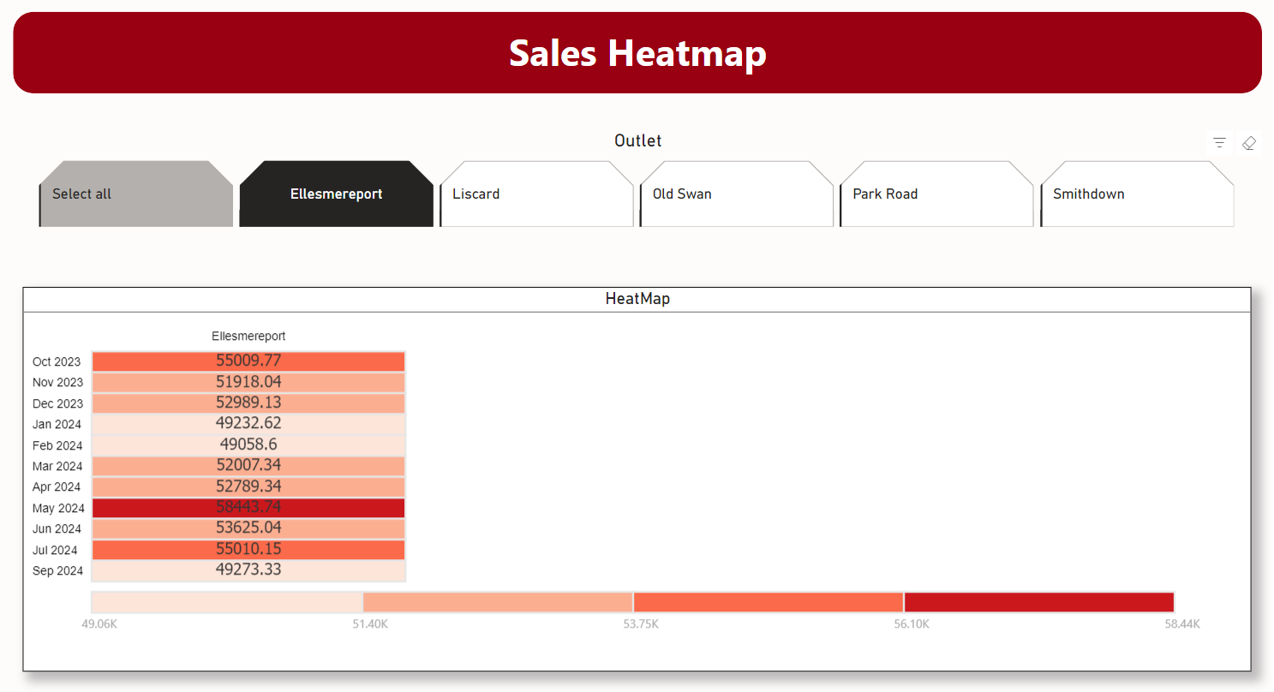
Sales Heatmap
It shows the low and high monthly sales in all outlets in the form of color spectrum.
Color code: Darker color shows highest sale while Lighter color shows the Lowest sale

Slide 4
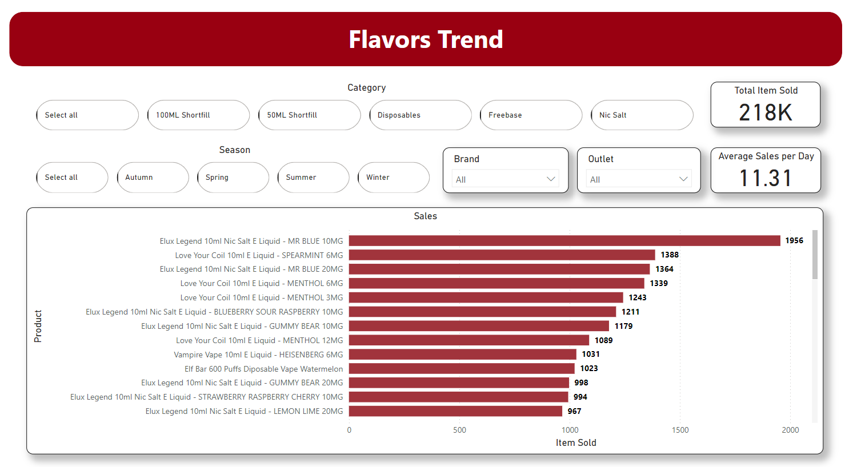
Flavor Sales Trend (Seasonal)
It shows the sales of all 7000 flavors in all 5 outlets for all 4 seasons
Guide: We can select product category, season, brand & outlet of our choice using slicers and visuals (bar chart) will update itself

